Slide 1
Amex GBT
Mobile App
User guide

Slide 2
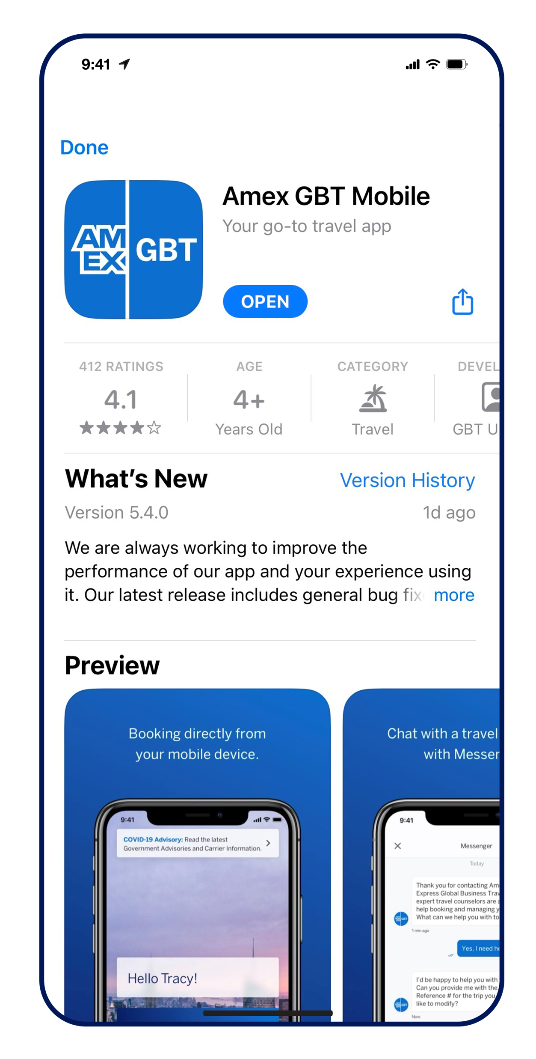
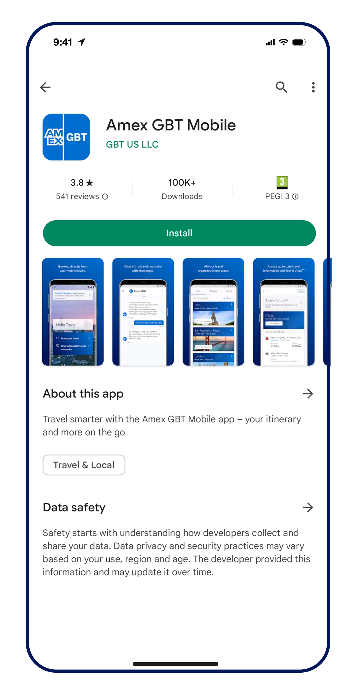

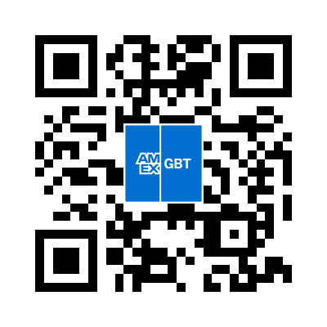

App store options
Download the
Amex GBT Mobile app now!
Apple App and Google Play

Slide 3
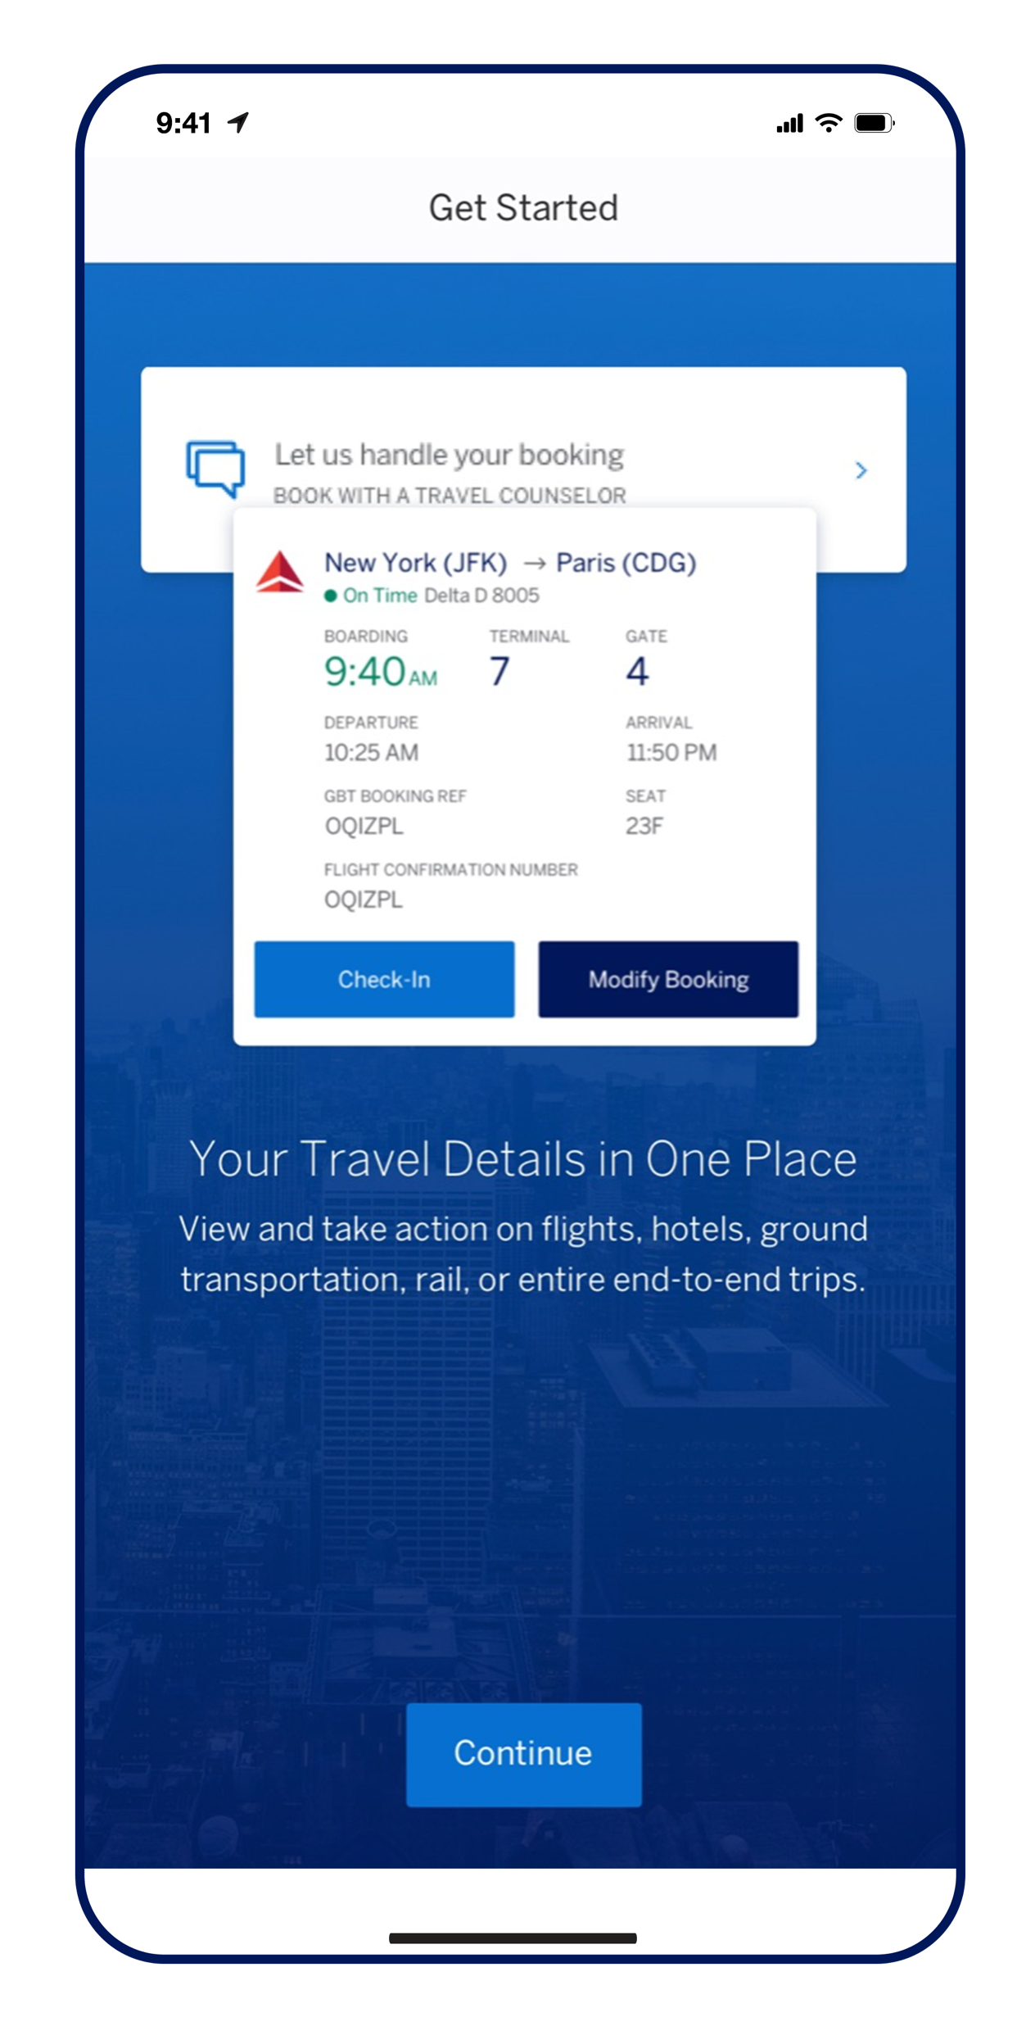
Get started tutorial
Our Get Started tutorial will automatically pop up the first time you log in to the Amex GBT Mobile app to help you learn how to use it.
You can also access the tutorial at any time from your account under “Did you know?”.

Slide 4
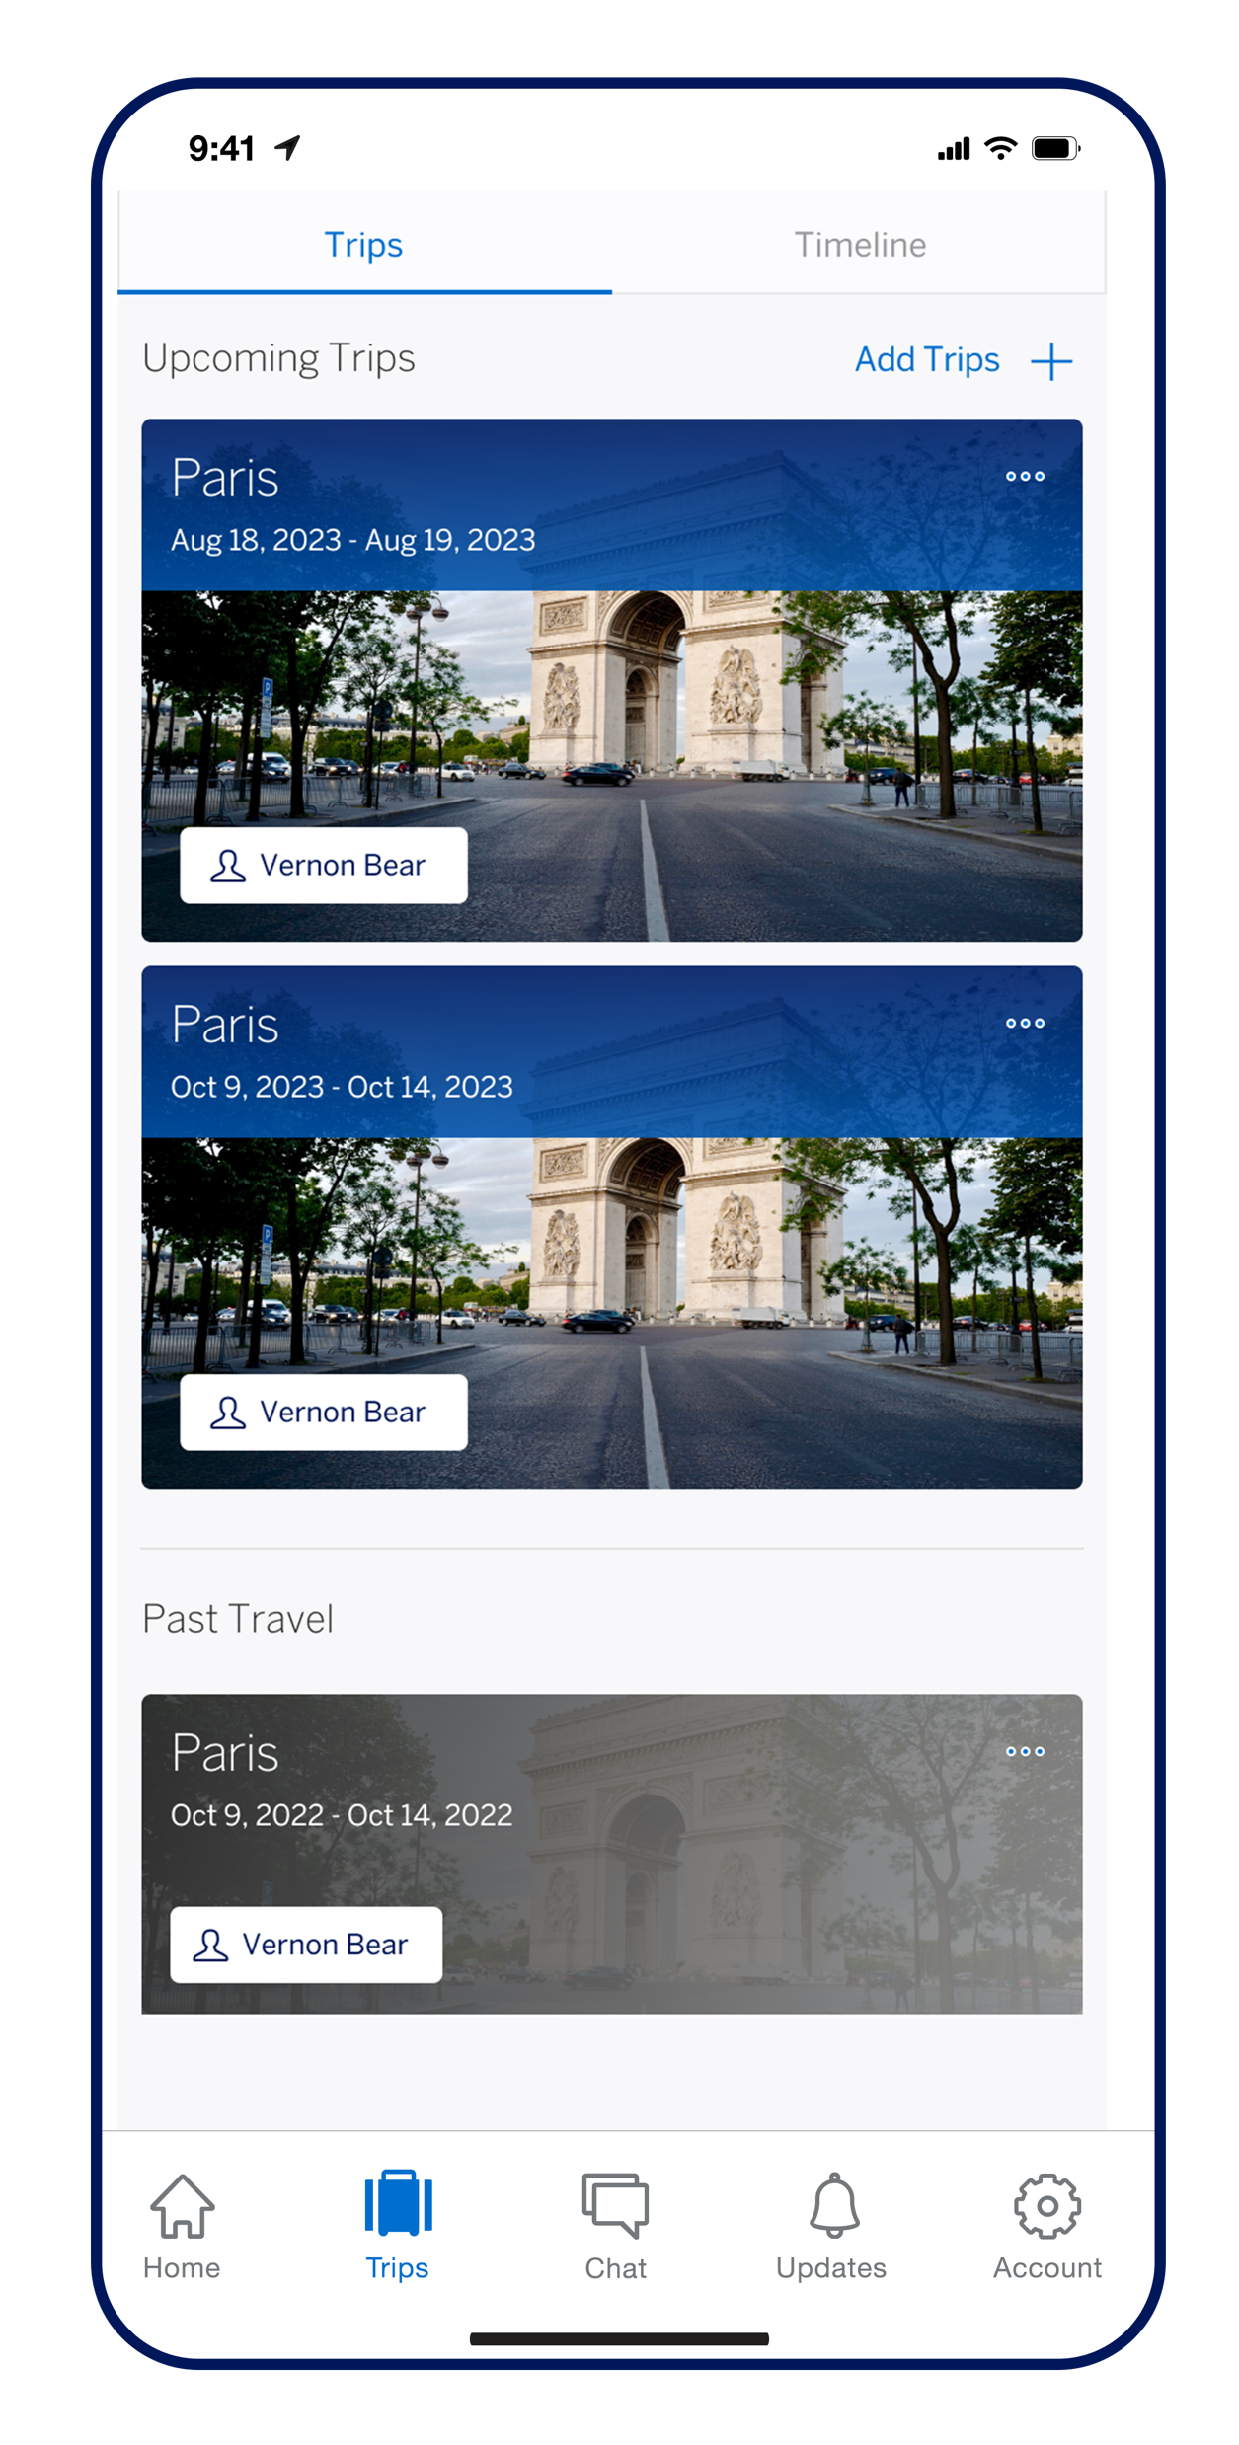
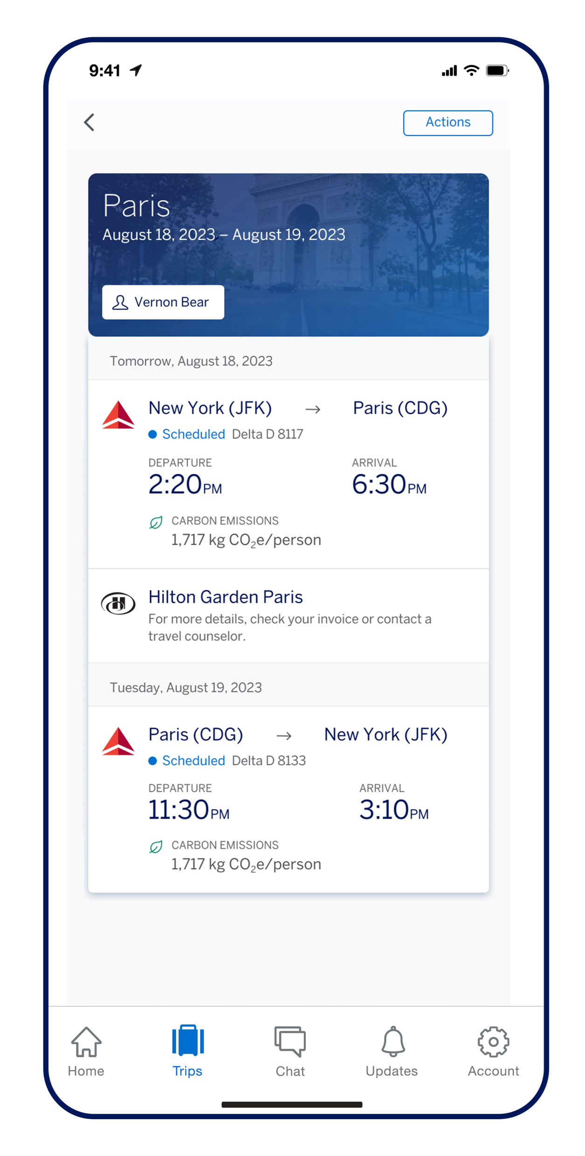
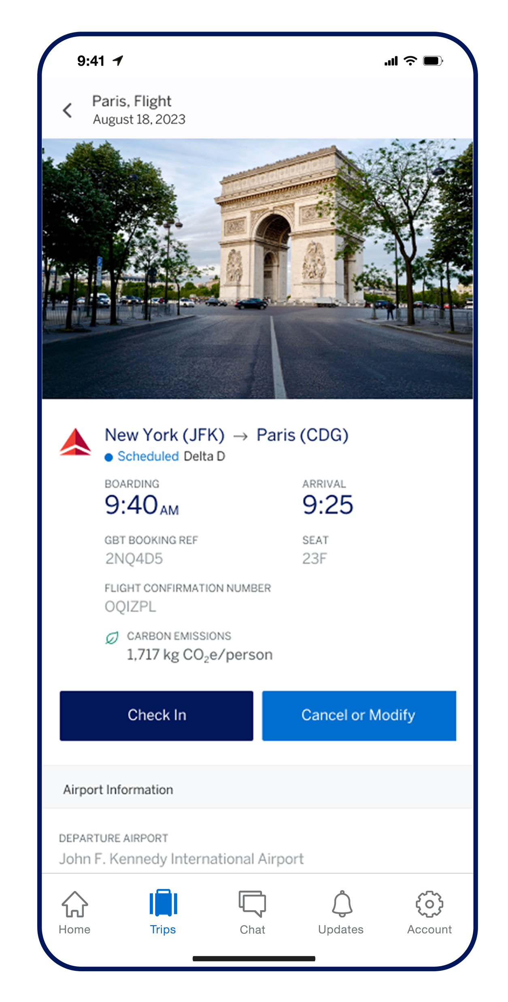
Trip management
The Trips tab is on the bottom of the home screen, where you can view all your upcoming and past trips.
Upon opening a trip itinerary, you can see real-time information for:
Flight
check-in
Hotel
room
Ground transportation
Departure/
arrival times
Gate
location
Flight carbon emissions

Slide 5
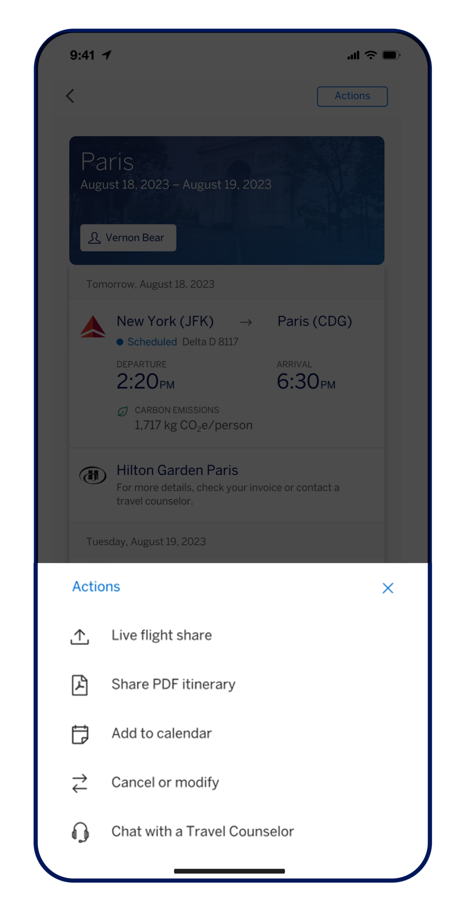
Trip management
You can access additional trip details from the Actions menu:
Share real-time flight status
Share
itineraries
Add trip details
to any calendar
Contact a travel counselor

Slide 6
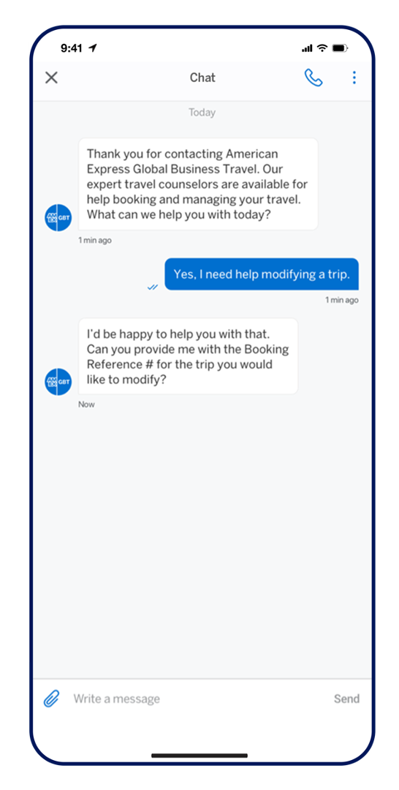

Chat
Chat with a live American Express Global Business Travel (Amex GBT) travel counselor to get help during your trip or in the event of a travel disruption. You can rebook a missed flight or book a new trip entirely.
With our conversational artificial intelligence technology, you can:
Receive your itinerary.
Get an invoice.
Book, change, or cancel a trip.
Ask any trip-related questions for
a quick response.
Get transferred to a travel counselor.

Slide 7
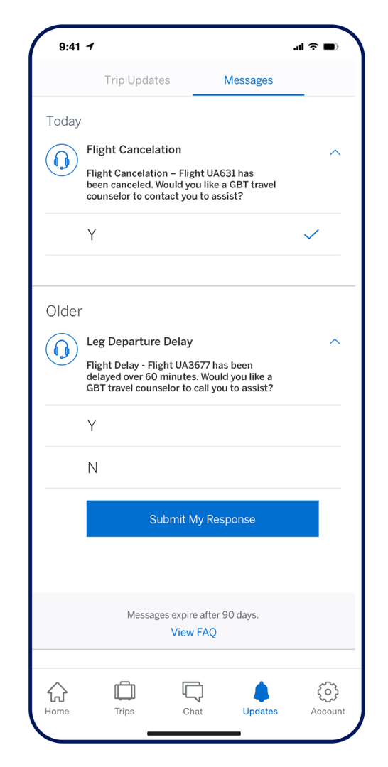
Proactive Traveler Care™
Receive messages to get proactive help with flight cancelations, delays, and potential missed connections.

Slide 8
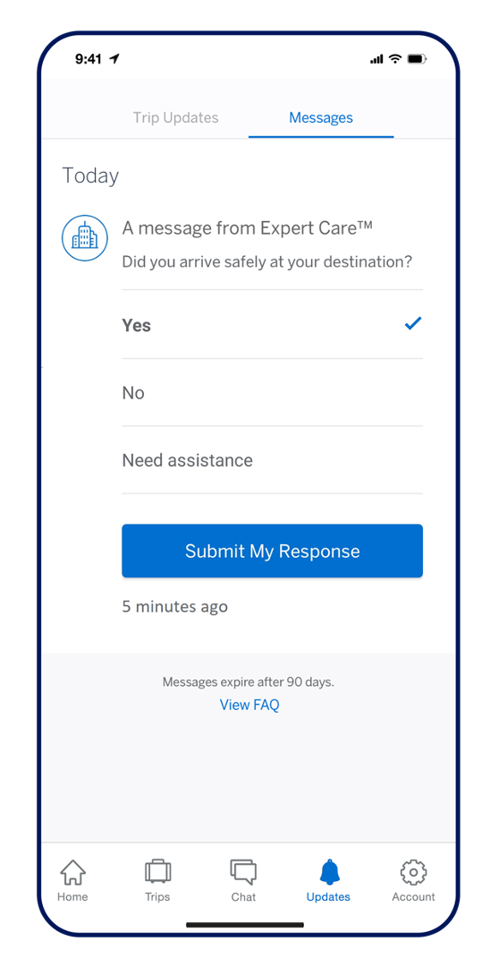
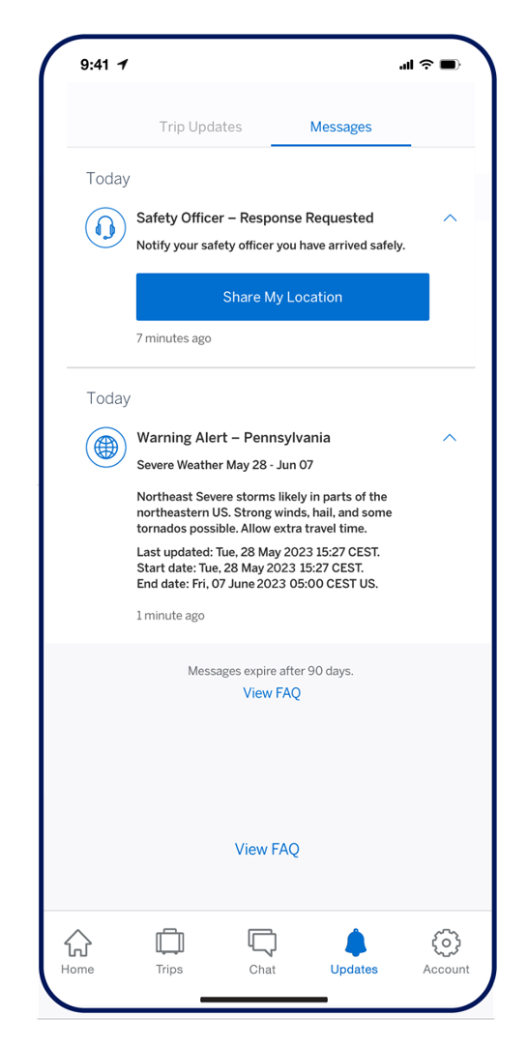
Expert Care™
In moments of potential risk, your company can communicate in
real time with you.
Push messages alerting you of situations.
Two-way response messages to ensure you are safe.
Requests to share your device geolocation to augment location data based on your itinerary.

Slide 9
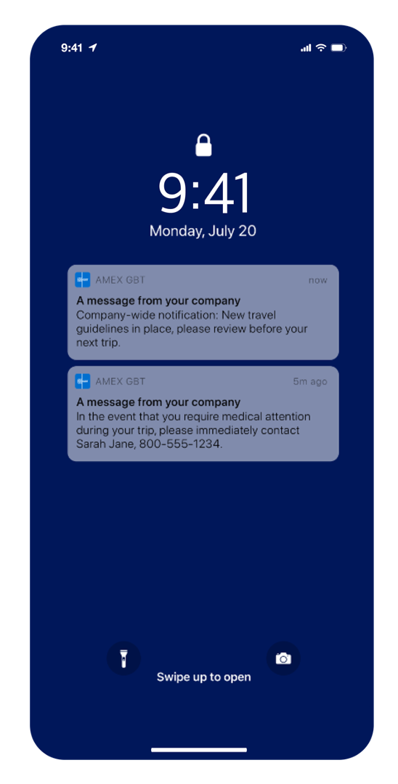
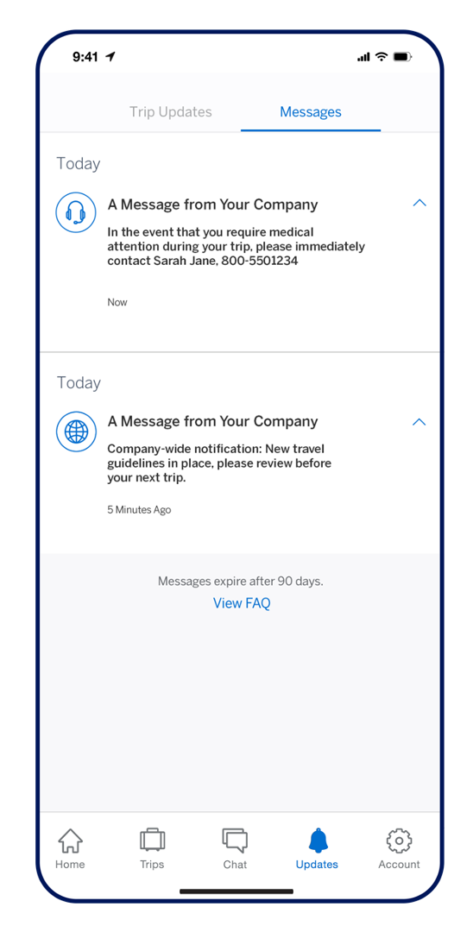
Program alerts
Receive important company messages and keep up to date on any relevant issues.

Slide 10
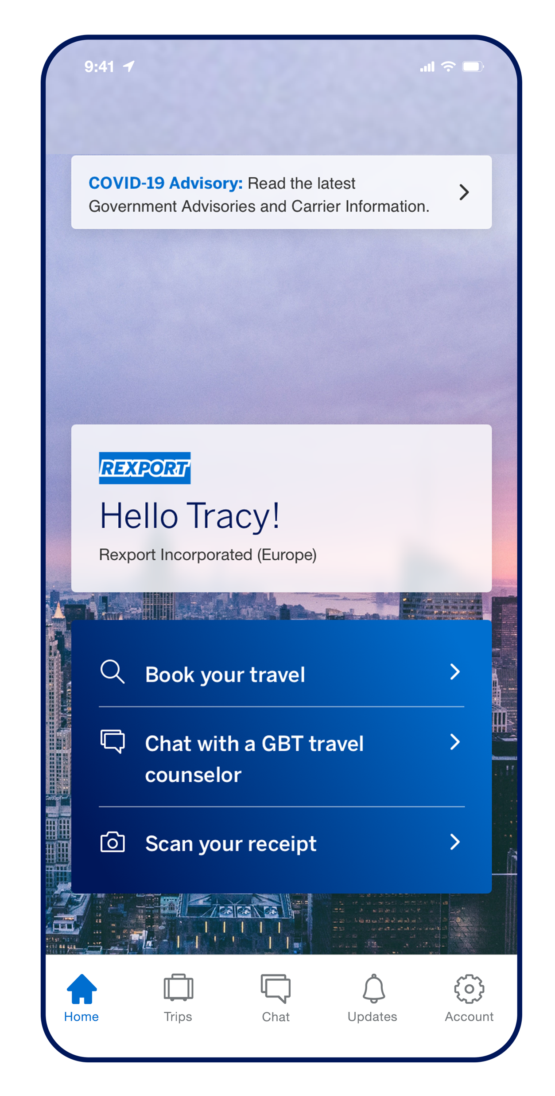
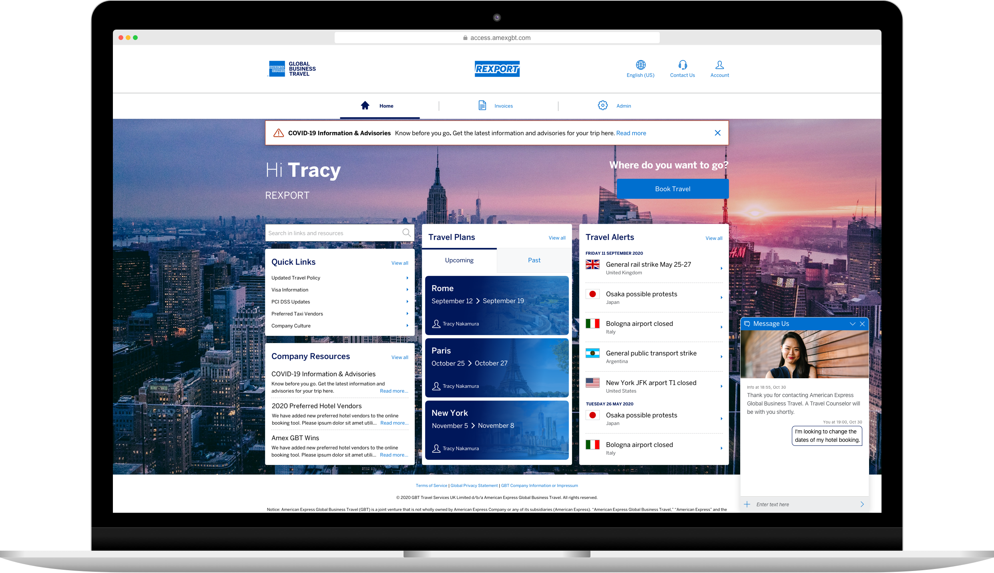
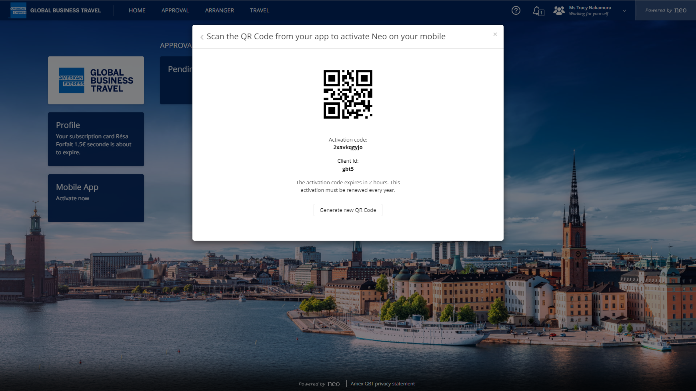
Amex GBT Neo
Activate mobile booking
Download and login to the Amex GBT Mobile app to get started.
  Tap on “Book your travel.”
  Please grant the camera access when prompted. If you “Don't Allow,” then you’ll need to go into Settings, find Amex GBT, and enable Camera from there.
  On the desktop, log in to your Amex GBT Neo (Neo^{™️)} account to retrieve your QR code, click on the tile that reads “Mobile App: Activate Now”.

Slide 11
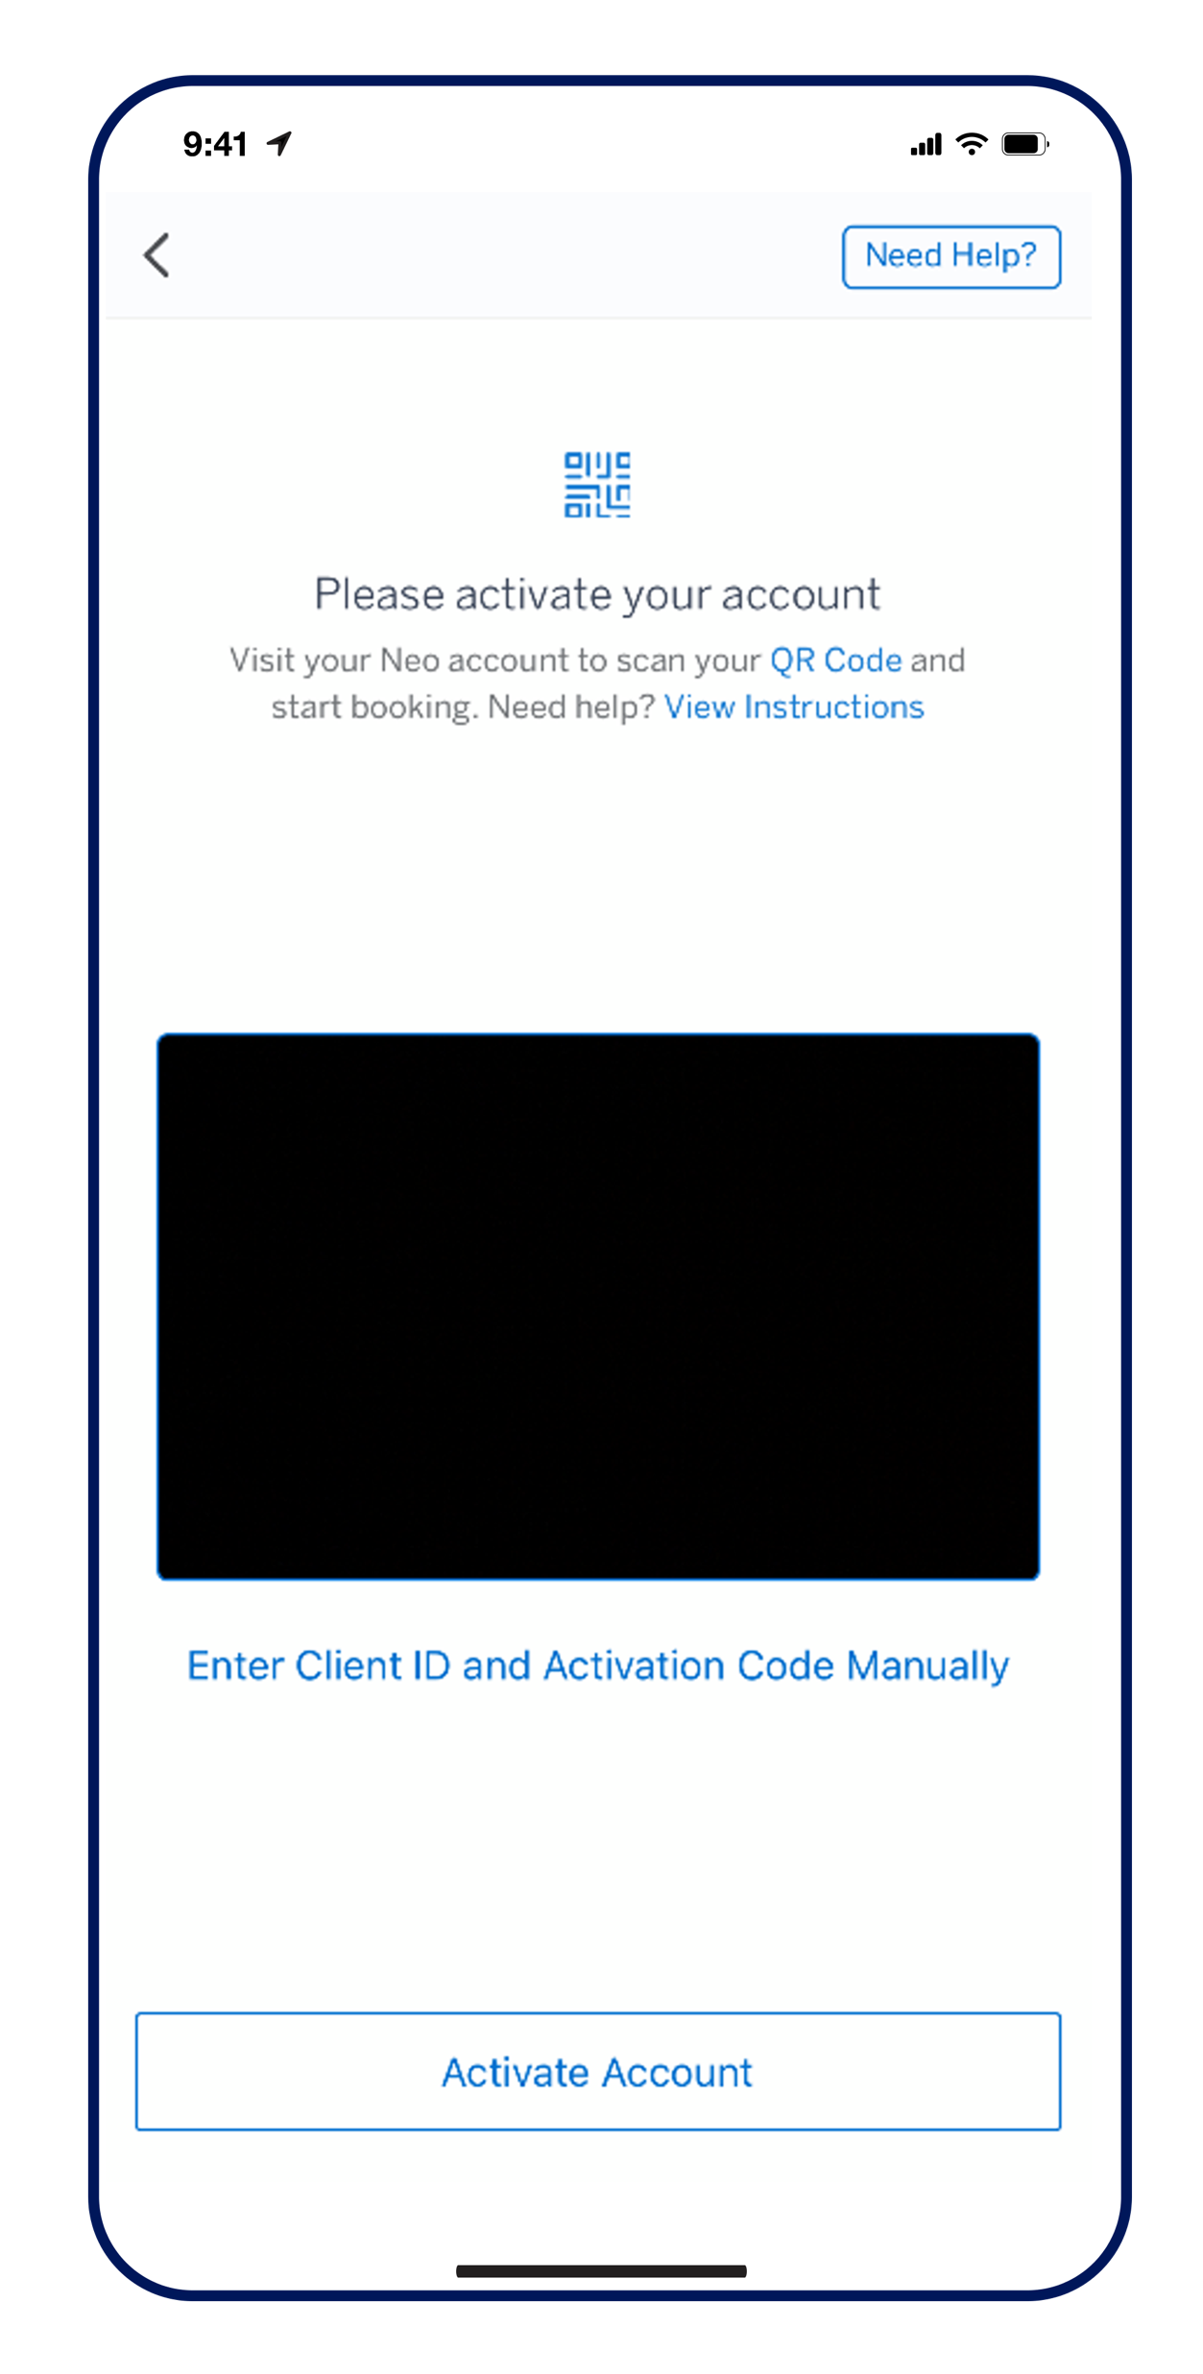
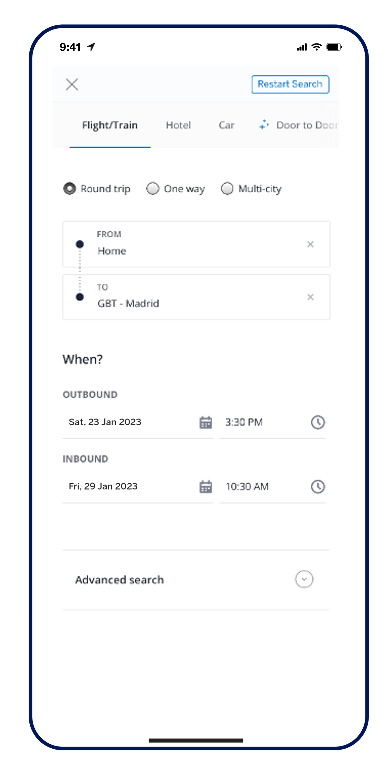
Neo™
Activate mobile booking
  Scan your unique QR code from your desktop screen.
  Once the QR code is recognized, the “Activate Account” button on the bottom should turn blue; tap on it.
After a moment, your Neo™ account should be activated on your app.
Once your Neo™️ account is connected, tap on “Book your travel” to access the default booking screen to book:
Air
Train
Hotel
Car
Scan QR code and tap on Activate Account.
Book, modify, or cancel your trip!

Slide 12
Download the Amex GBT Mobile app today!

